Slide 1


Multi-Agent AI System for Risk-Aware, Explainable Hydrocarbon Exploration
Explainable, risk-aware AI for faster and smarter hydrocarbon exploration.
Advisor: Dr. Ankur Pandey | RGIPT | IEW Hackathon 2026
Team: Prathamesh Dhote | Eishaan Khatri | Rahul Raj | Rajesh Yadav

Slide 2
The Challenge in Hydrocarbon Exploration
Impact:
Uncertainty & lack of interpretability
Low trust from geoscientists.
Regulatory pressure demands transparent, risk-audited AI recommendations.
Complexity
Risk
Speed
Traditional exploration methods struggle with vast geological data and uncertain subsurface conditions.
Current ML models are black-box, domain-specific, and lack uncertainty & ESG integration.
High financial stakes demand accurate predictions to minimize costly drilling failures.
Each exploration well can cost $50 M – $500 M, yet only ~30 % succeed.
Industry needs faster decision-making to stay competitive in dynamic energy markets.
Poor decisions lead to non-productive drilling, CO₂ footprint, and financial loss

Slide 3



Why Multi-Agent AI?
Explainable Multi-Agent Intelligence for Smarter Drilling
Collaborative Intelligence
Risk Assessment
Explainability
Multiple AI agents work together, each specializing in different aspects of exploration analysis.
Dedicated agents evaluate geological, financial, and operational risks in real-time.
Transparent decision-making process shows how conclusions are reached, building trust.

Slide 4
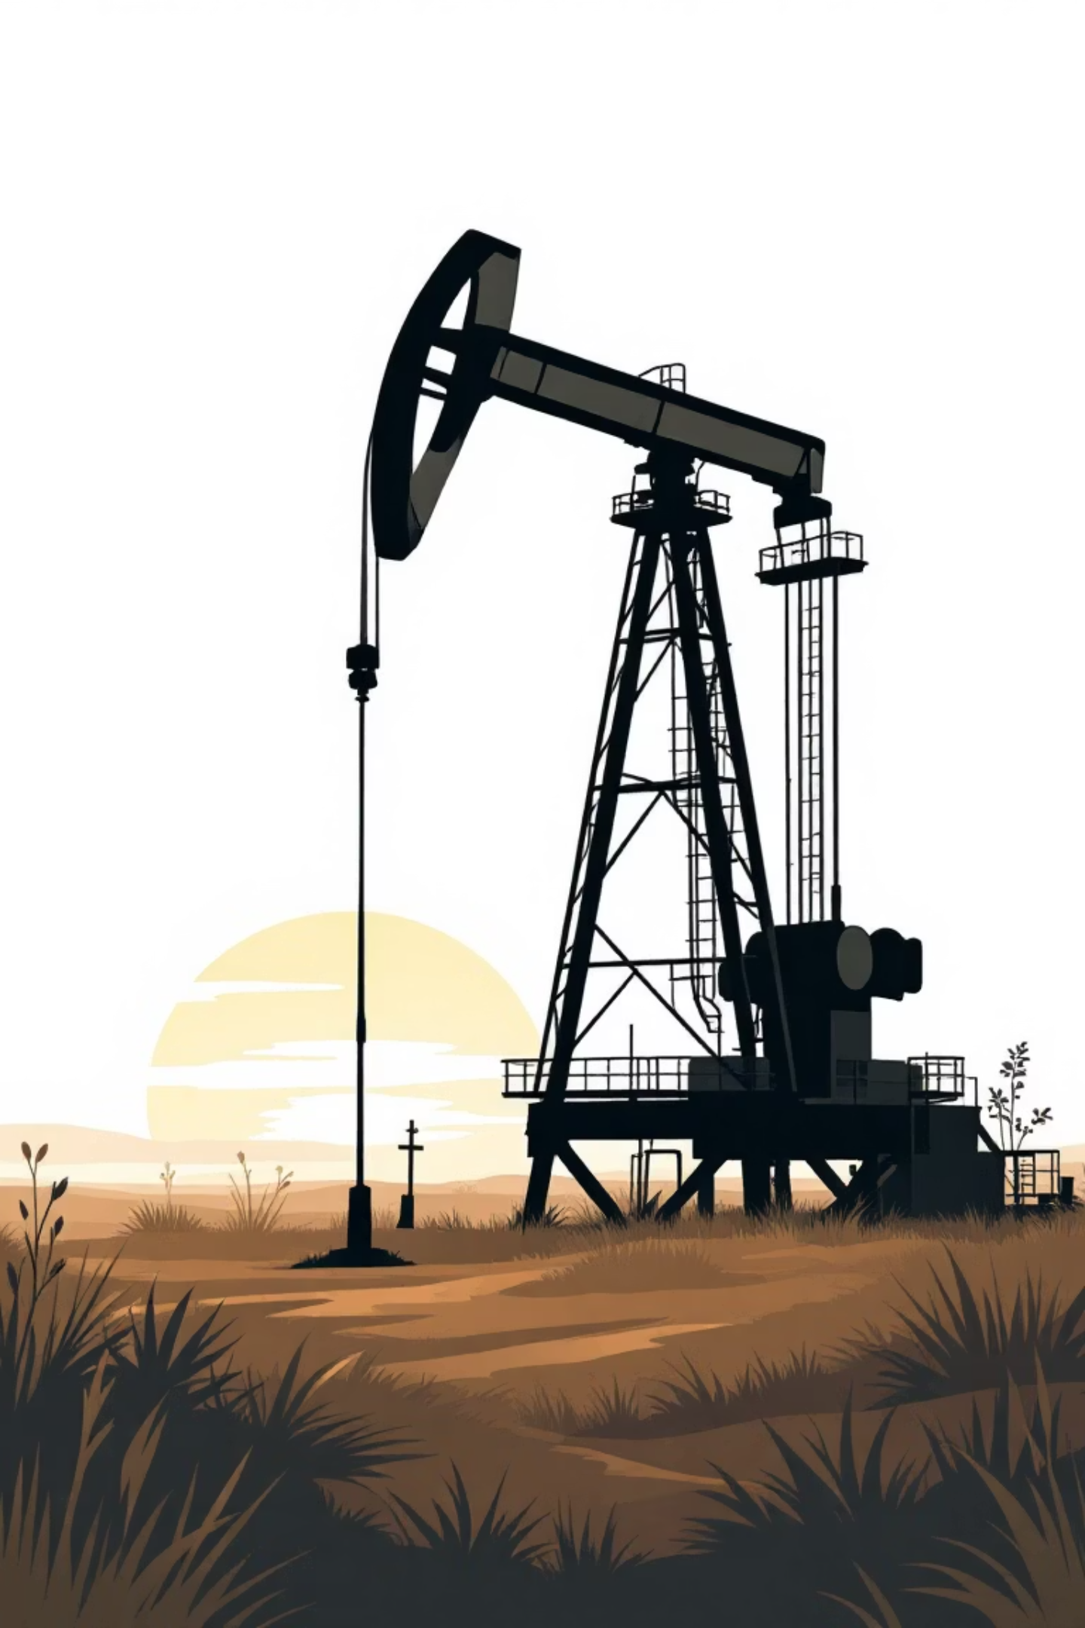
Explainable Multi-Agent Intelligence for Smarter Drilling
A cutting-edge AI system that combines four specialized agents—Seismic, Petrophysical, Reservoir, and Risk/ESG—to deliver trustworthy, explainable drilling decisions.
Each agent is trained on domain-specific data using advanced models including CNNs, XGBoost, and Bayesian Monte Carlo simulations.
The system's Consensus Engine uses weighted voting, uncertainty fusion, and hard ESG veto logic to output ranked drill targets with confidence intervals, SHAP explanations, and NPV forecasts.
This approach ensures ESG-compliant, financially optimized exploration that engineers and investors can trust.

Slide 5



Risk-Aware Decision Making
35%
25%
40%
Geological Risk
Technical Risk
Economic Risk
Uncertainty in reservoir presence and quality
Drilling and operational challenges
Market conditions and project viability
Our system quantifies and visualizes multiple risk dimensions, enabling stakeholders to make informed trade-offs between potential rewards and uncertainties.

Slide 6




System Architecture
Data Ingestion Agent
Collects and preprocesses seismic, geological, and historical drilling data.
Analysis Agent
Applies machine learning models to identify potential hydrocarbon reservoirs.
Risk Evaluation Agent
Assesses probability of success and potential hazards for each prospect.
Explanation Agent
Generates human-readable reports detailing reasoning and recommendations.

Slide 7
System Architecture
Our multi-layered architecture processes diverse upstream data through specialized pipelines, delivering actionable intelligence with full explainability.
01
02
Input Layer
Processing Pipelines
3D seismic data (SEG-Y format), FORCE 2020 well logs (LAS), production histories, economic parameters, and comprehensive ESG datasets feed the system.
Automated data ingestion, cleaning, normalization, and attribute extraction populate a centralized feature store for agent consumption.
03
04
Agent Layer
Consensus Layer
Four specialized agents analyze data: Seismic Agent (CNN + Attention), Petrophysical Agent (XGBoost + CNN), Reservoir Agent (ResCNN + MLP), and Risk/ESG Agent (Bayesian Monte Carlo).
Confidence-weighted fusion (w = 1/σ²) integrates agent outputs, SHAP attribution explains feature importance, and ESG veto ensures compliance.
05
06
LLM Layer
Output Layer
Structured prompts containing agent summaries, uncertainties, and geological maps enable reasoning, consistency checking, and human-readable report generation.
Ranked drill targets, uncertainty bands, NPV distributions, and interactive dashboards with chatbot support deliver actionable recommendations.

Slide 8
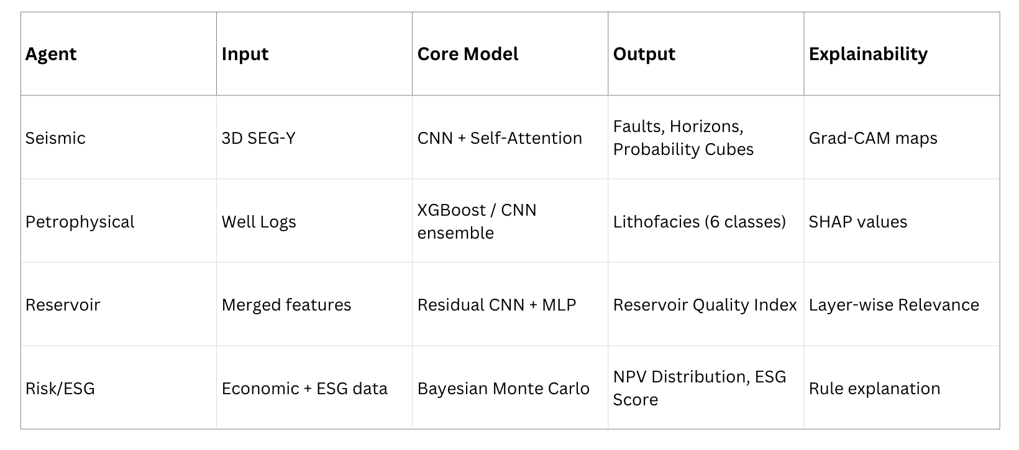
Inside the Agents

Slide 9
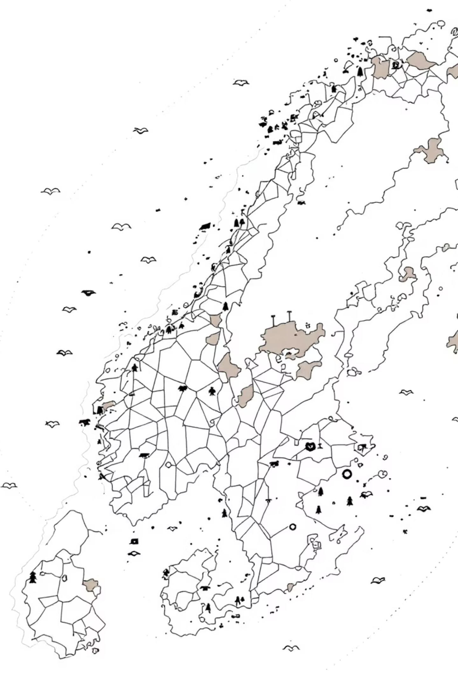



Data Foundation & Implementation Scale
FORCE 2020 Dataset
Lithology Classes
Norwegian Continental Shelf data comprising 98 wells with approximately 75,000 analysis windows generated using 50-sample windows with 50% overlap for comprehensive coverage.
Sandstone
Claystone
Chalk
Log Curves (10 Total)
Marl
GR, NPHI, RHOB, DTC, DTS, RDEP, RMED, PEF, CALI, BS — covering the full spectrum of petrophysical measurements required for robust lithology identification.
Dolomite
Halite
LAS Parsing
95% success rate in automated data extraction and format validation
Sliding Windows
50 samples per window, 25-sample stride generating 70 features per window
Normalization
0–1 scaling with stratified split: 70% train, 15% validation, 15% test

Slide 10
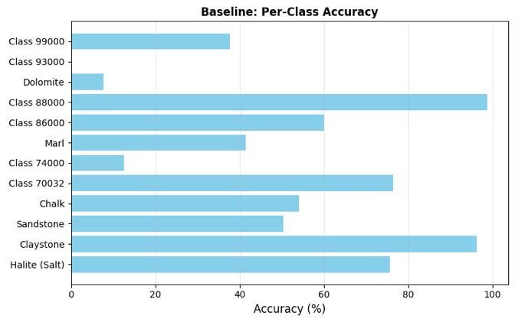
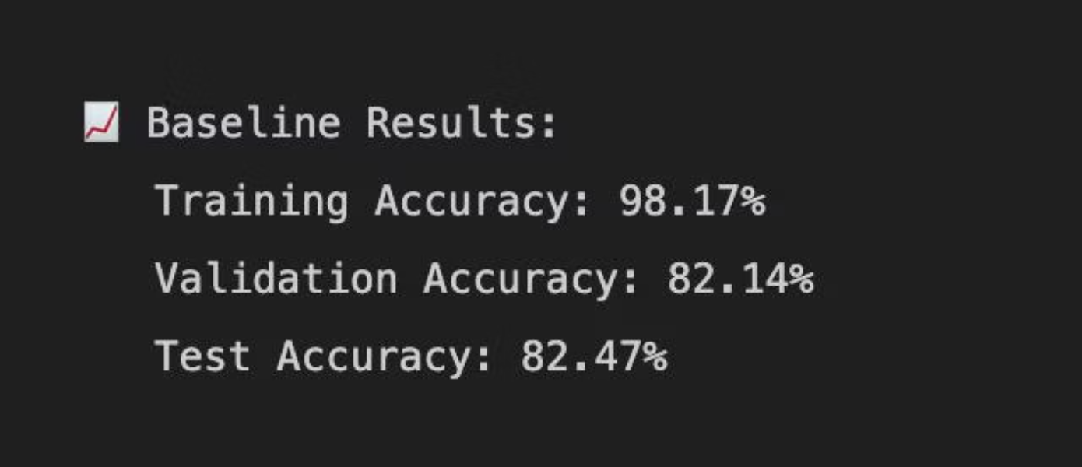
Petrophysical Agent
The Petrophysical Agent combines deep learning with gradient-boosted trees to classify lithology from well log signatures with exceptional accuracy.
Model Architecture
1D CNN with attention mechanisms paired with XGBoost ensemble
Performance Metrics
Overall Accuracy: 85.2%
F1 Score: 0.84
Model Parameters: ~2.1M
Top Classifications
Sandstone: 89% accuracy
Halite: 91% accuracy
Claystone: 82% accuracy
The model demonstrates robust performance across diverse lithological classes, with MC Dropout (20 iterations) providing reliable uncertainty quantification for downstream decision-making.

Slide 11
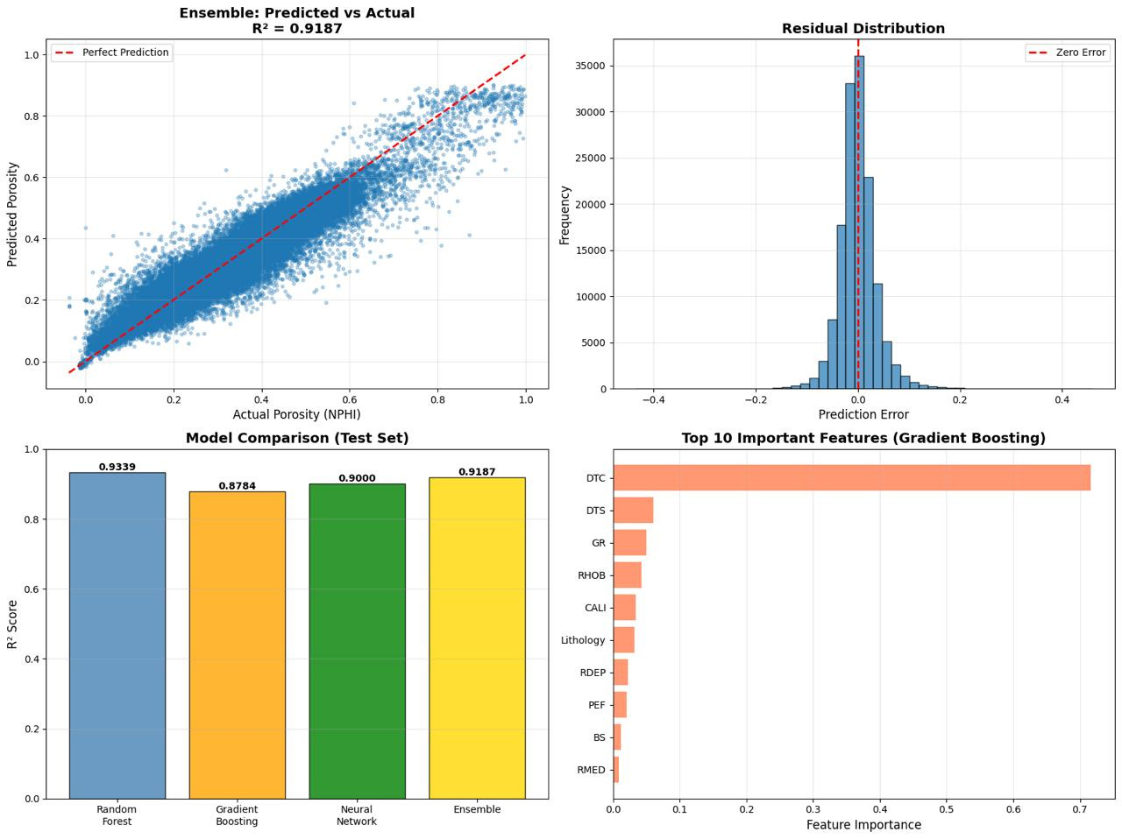
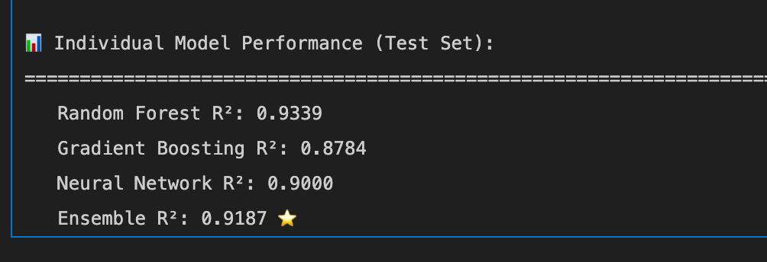
Reservoir Agent
Model: Residual CNN + MLP
Target: Porosity & reservoir quality index
Metrics:
R² = 0.91
RMSE = 0.028

Slide 12

Initial Results
Early validation demonstrates strong predictive performance across both classification and regression tasks. These models are under active development as we refine the complete end-to-end workflow.
Petrophysical Agent
Reservoir Agent
Lithology Classification
NPHI Regression
Accuracy: 85.2% (↑3.2% from baseline RF)
R² Score: 0.91 (validation: 0.92)
F1 Score: 0.84
RMSE: 0.028
Model Size: ~2.1M parameters
MAE: 0.021
Per-Class Performance: Sand 89%, Halite 91%, Dolomite 86%, Clay 82%, Chalk 78%, Marl 81%
Feature Importance: Bulk Density (32%), Lithology (18%), GR (14%)
Ensemble architecture delivers 3–5% performance boost over single models, with exceptional generalization to held-out wells.
MC Dropout with 20 iterations provides robust uncertainty estimates.

Slide 13
Sample Output
DRILLING DECISION REPORT
========================
Well: 15/9-19A
Depth: 2,450m
Date: 2024-11-17
RECOMMENDATION: ✅ DRILL - HIGH PRIORITY
Confidence: HIGH (Score: 78/100)
GEOLOGICAL ASSESSMENT:
• Lithology: Sandstone (Agent 1 confidence: 92%)
• Porosity: 28% (Agent 2 R² = 0.91)
• Uncertainty: Low (MC Dropout σ = 0.03)
RESERVOIR QUALITY:
• Estimated Permeability: 500 mD (good)
• Expected Production: 450 BOPD
• Reservoir Grade: EXCELLENT
RECOMMENDED ACTIONS:
✅ Proceed with drilling operations
✅ Allocate $4.2M budget
✅ Target completion Q1 2025
⚠️ Monitor oil price trends
ECONOMIC ANALYSIS:
• 10-Year NPV: $12.5M
• Drilling Cost: $4.2M
• Breakeven Oil Price: $42/bbl
• Current Oil Price: $85/bbl
• IRR: 28%
RISK ASSESSMENT:
• Technical Risk: LOW
• Geological Uncertainty: 3% (very confident)
• Market Risk: MEDIUM (oil price volatility)
• Environmental Risk: LOW (offshore location)
DECISION BASIS:
1. High-confidence sandstone prediction (89% Agent 1 accuracy)
2. Excellent porosity (top 20% of dataset distribution)
3. Strong economic returns at current oil prices
4. Low technical/geological uncertainty
5. Proven reservoir analog in nearby wells

Slide 14
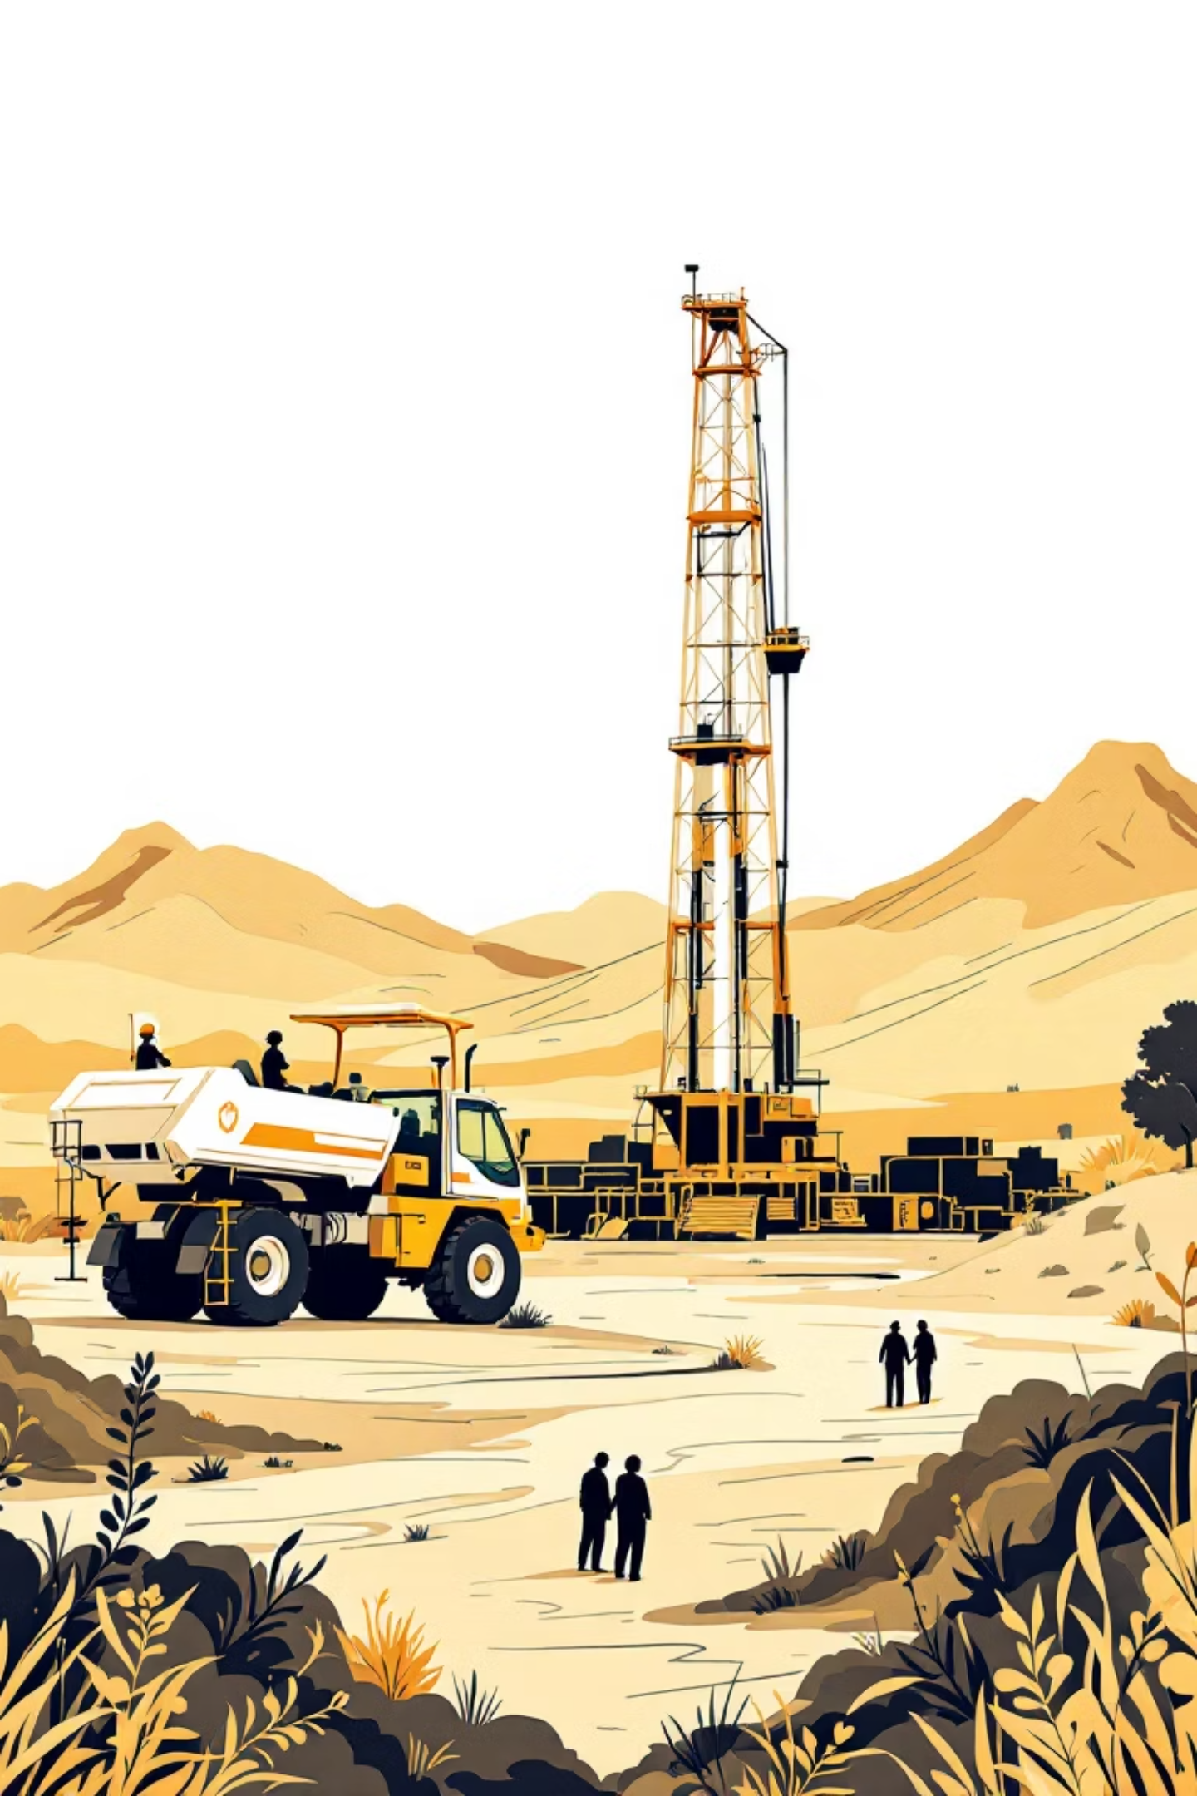
Expected Impact
40%
30%
50%
Faster Analysis
Cost Reduction
Success Rate
Reduced time from data collection to drilling decision
Fewer dry wells through improved targeting accuracy
Increased probability of discovering viable reserves

Slide 15



Technology Stack
Machine Learning
Cloud Computing
Visualization Tools
Deep learning models for seismic interpretation and pattern recognition in geological data.
Scalable infrastructure for processing massive datasets and running complex simulations.
Interactive dashboards for exploring results and understanding AI recommendations.

Slide 16
Roadmap to Implementation
Phase 1: Development
Phase 3: Validation
Build and train individual AI agents using historical exploration data.
Test system on real-world cases and refine based on expert feedback.
1
2
3
4
Phase 2: Integration
Phase 4: Deployment
Connect agents into unified system and develop explanation framework.
Roll out to exploration teams and provide training for effective use.

Slide 17




Transforming Hydrocarbon Exploration
Our multi-agent AI system combines cutting-edge technology with industry expertise to make hydrocarbon exploration faster, smarter, and more transparent.
Precision targeting of drilling locations
Comprehensive risk assessment
Full transparency in decision-making

